Slide 1
Virtual Machine and Linux Installation

Slide 2
Contents
Virtual Machine Installation
Linux Installation
Linux Quick Overview
Linux Installation Continue
Other Virtual Machine Installation (VM1, VM2, VM3)

Slide 3
Environment
VirtualBox 6.0.18
- https://www.virtualbox.org/wiki/Download_Old_Builds_6_0
Linux image – ubuntu 18.04.4 (64 bits) - http://old-releases.ubuntu.com/releases/18.04.4/
=> ubuntu-18.04.4-desktop-amd64.iso

Slide 4
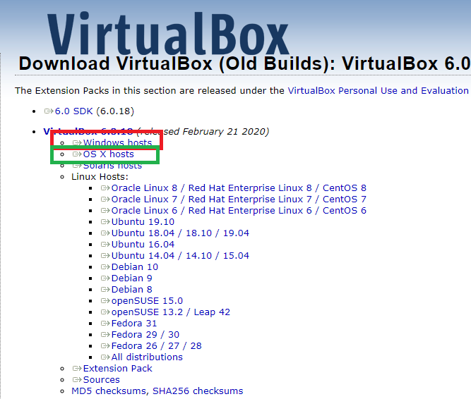
VirtualBox download page
Red Box – Windows
Green Box - Mac

Slide 5
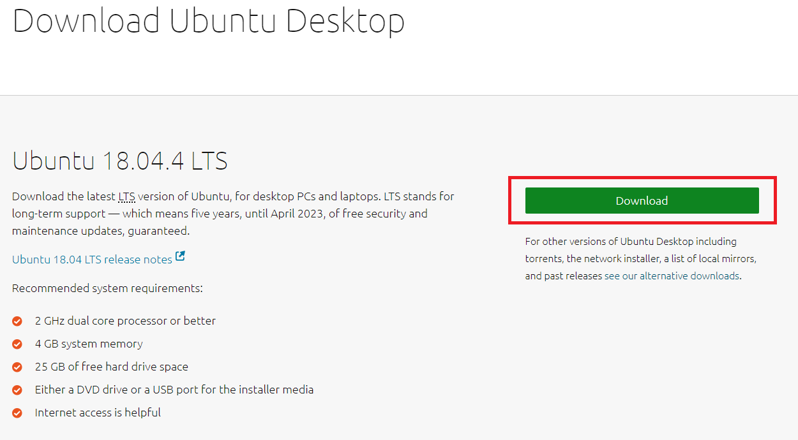
Click download (You don’t need to click after page changes)

Slide 6
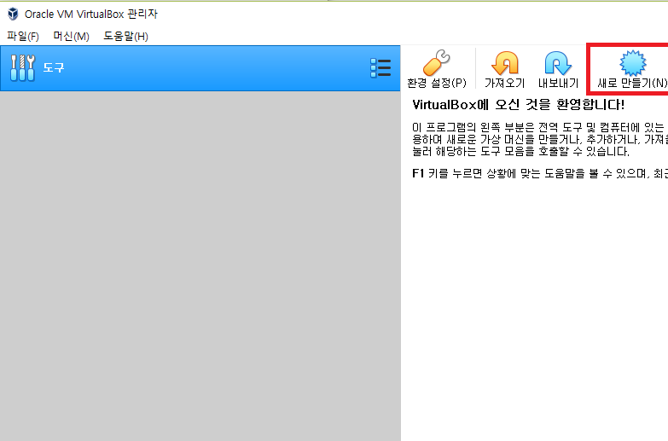
Creating a Virtual Machine

Slide 7
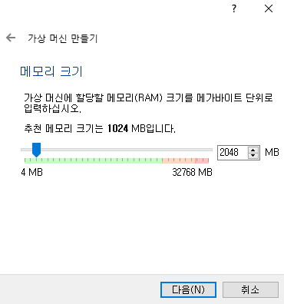
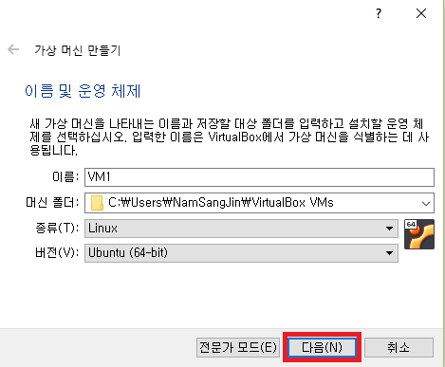
Creating a Virtual Machine

Slide 8
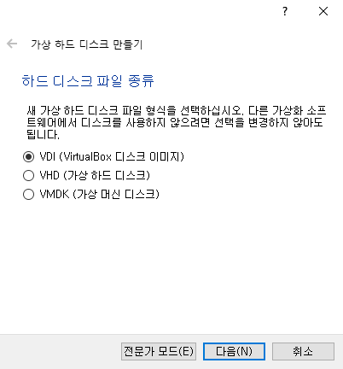
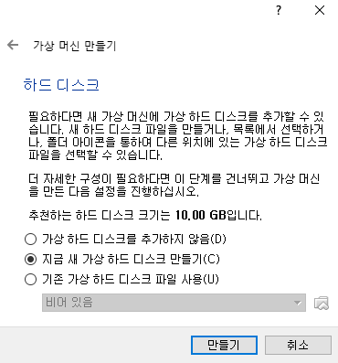
Creating a Virtual Machine

Slide 9
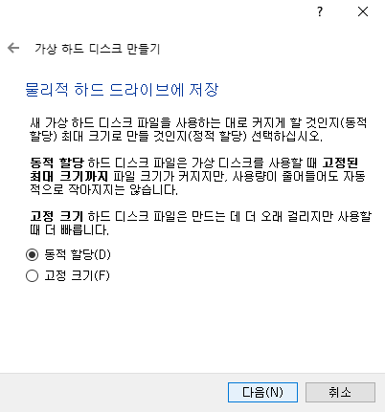
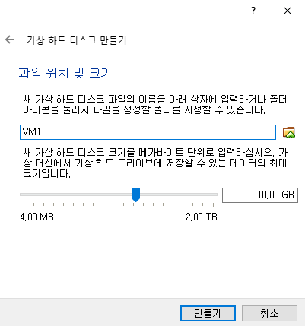
Creating a Virtual Machine

Slide 10
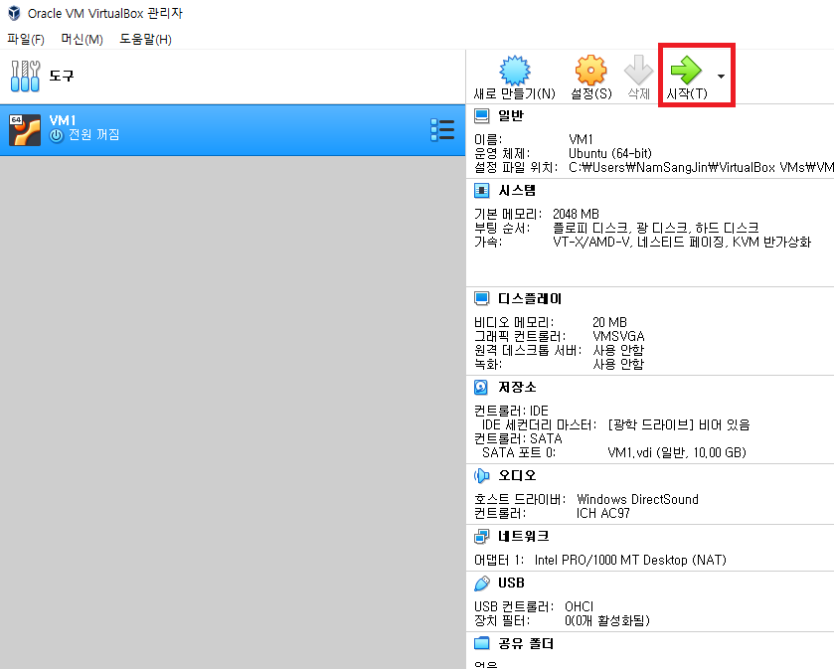
Linux Installation

Slide 11
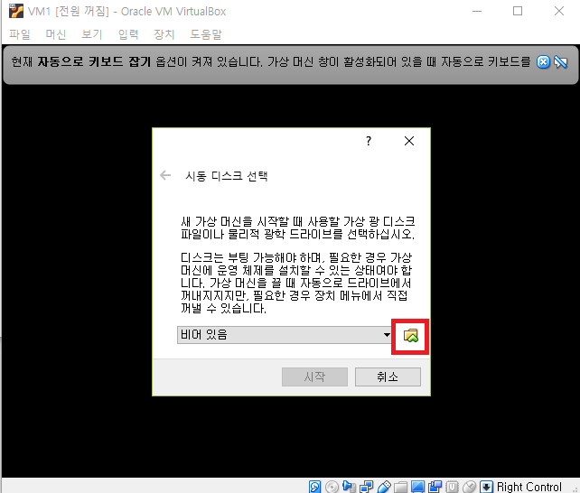
Linux Installation

Slide 12
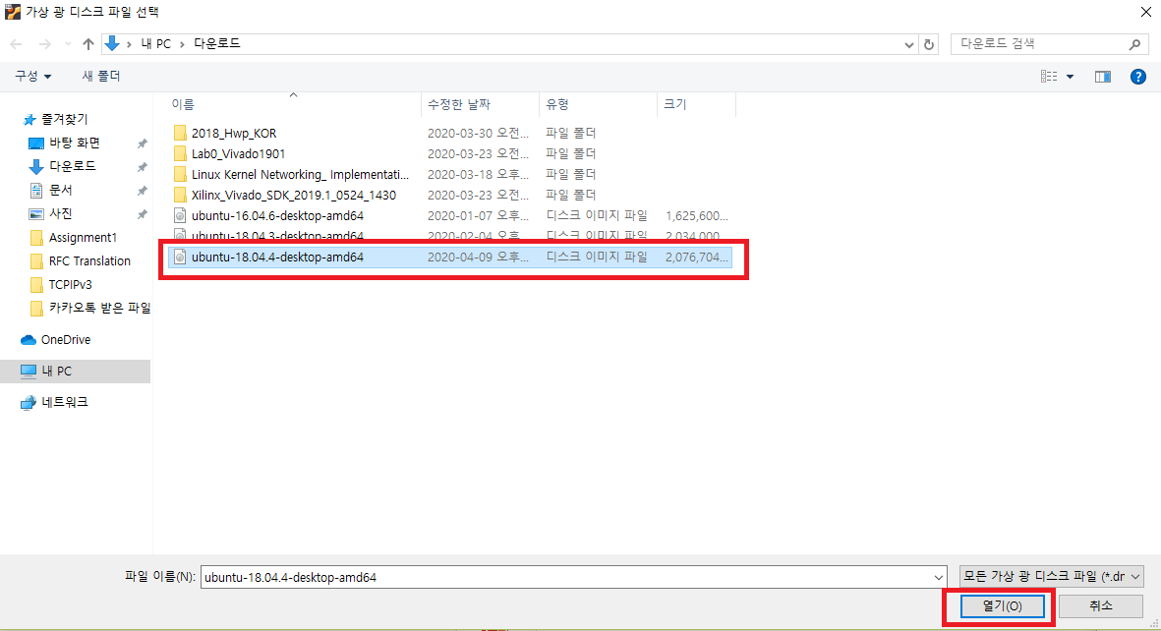
Linux Installation

Slide 13
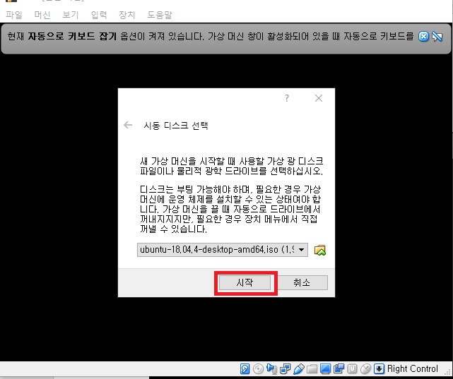
Linux Installation

Slide 14
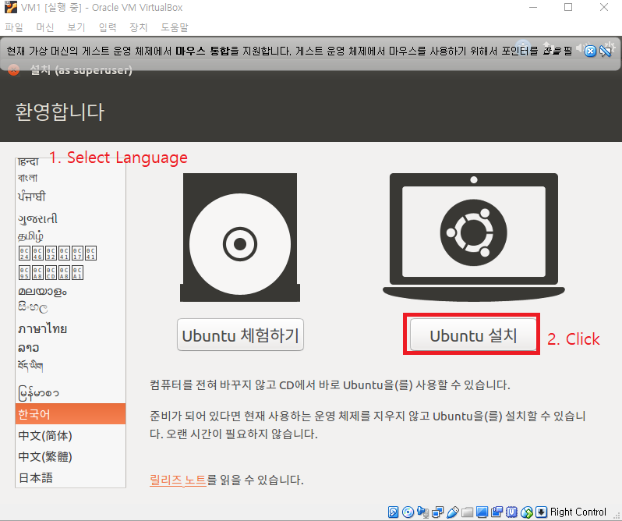
Linux Installation

Slide 15
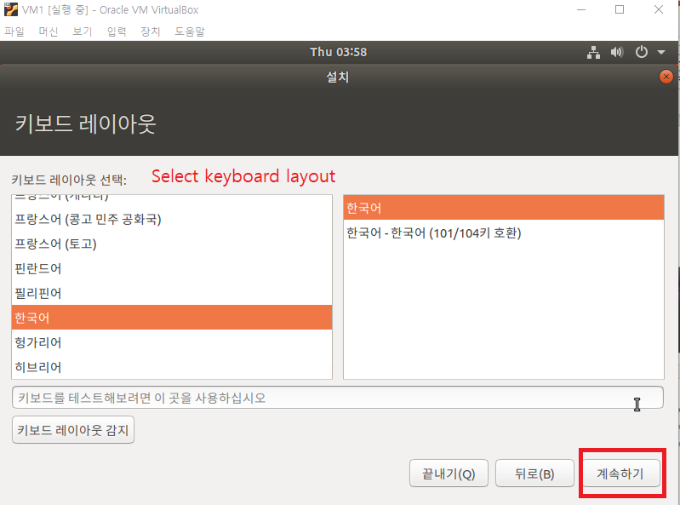
Linux Installation

Slide 16
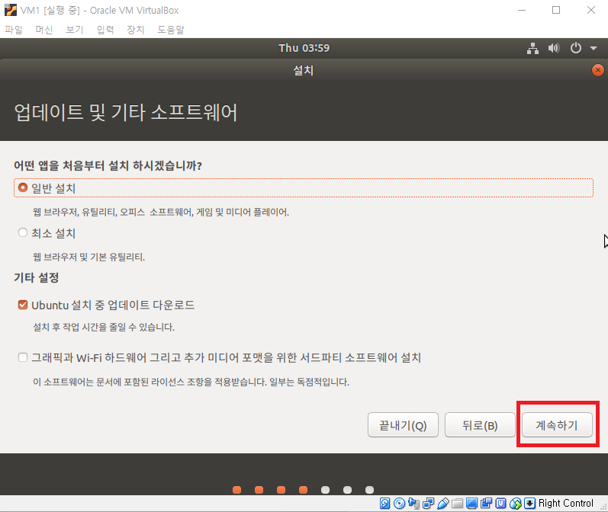
Linux Installation

Slide 17
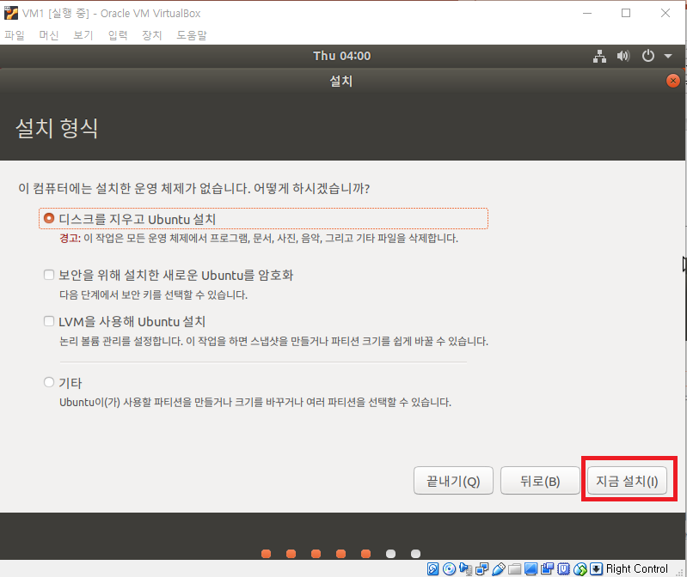
Linux Installation

Slide 18
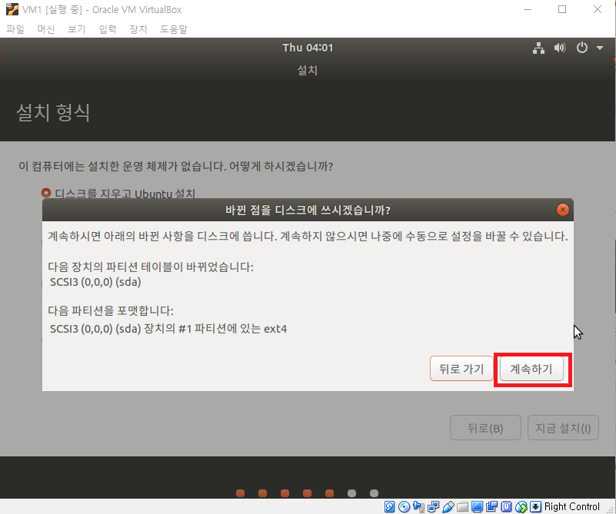
Linux Installation

Slide 19
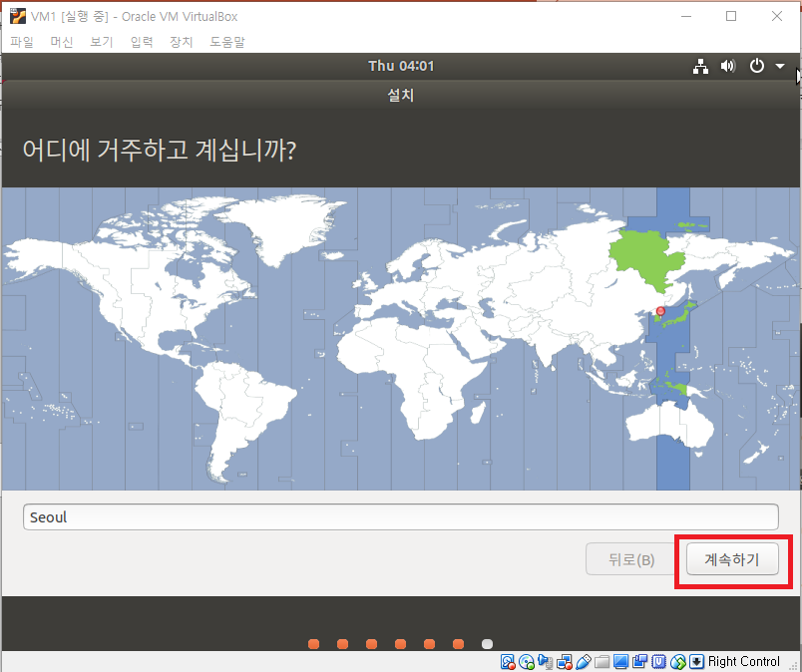
Linux Installation

Slide 20
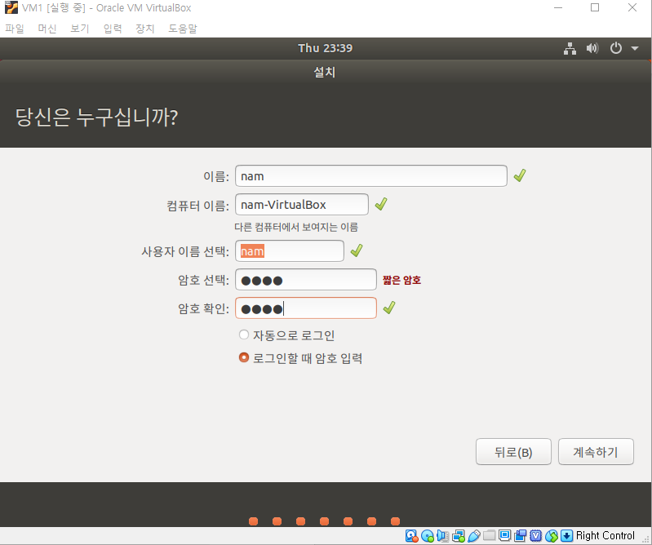
Linux Installation

Slide 21
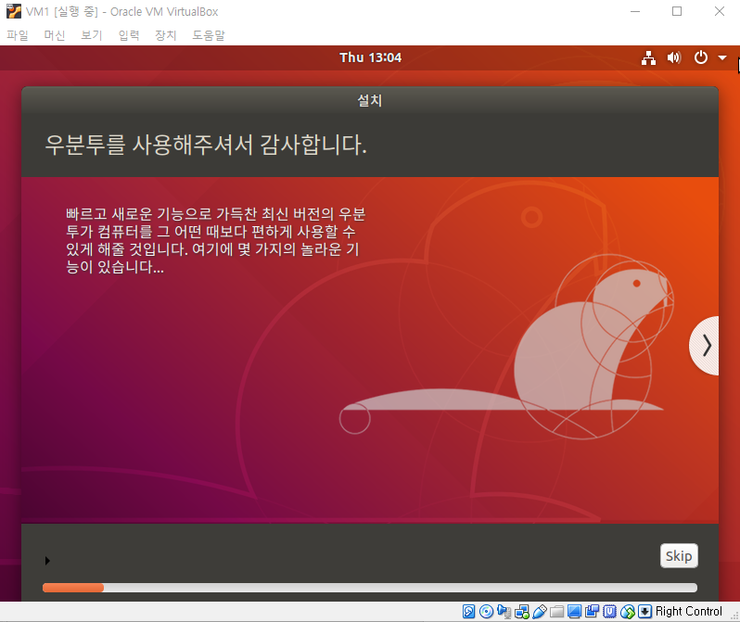
Linux Installation
Wait..
Installation End =>
Click Restart and
Press Enter after a while

Slide 22
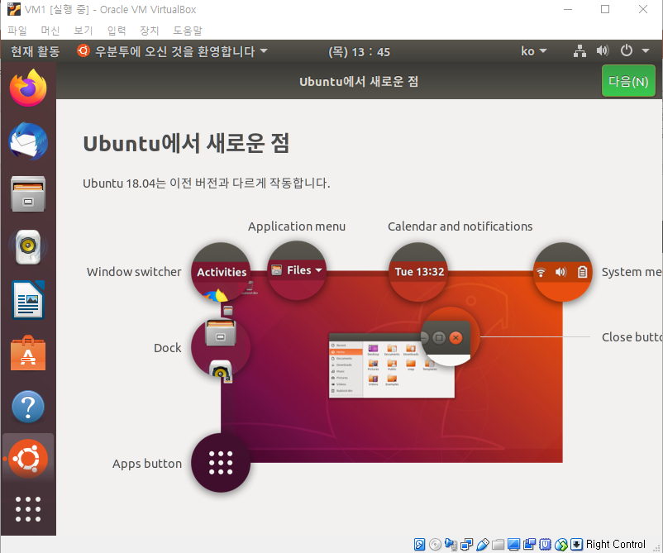
Linux Quick Overview
Click to
open terminal
System power
Firefox
Directory

Slide 23
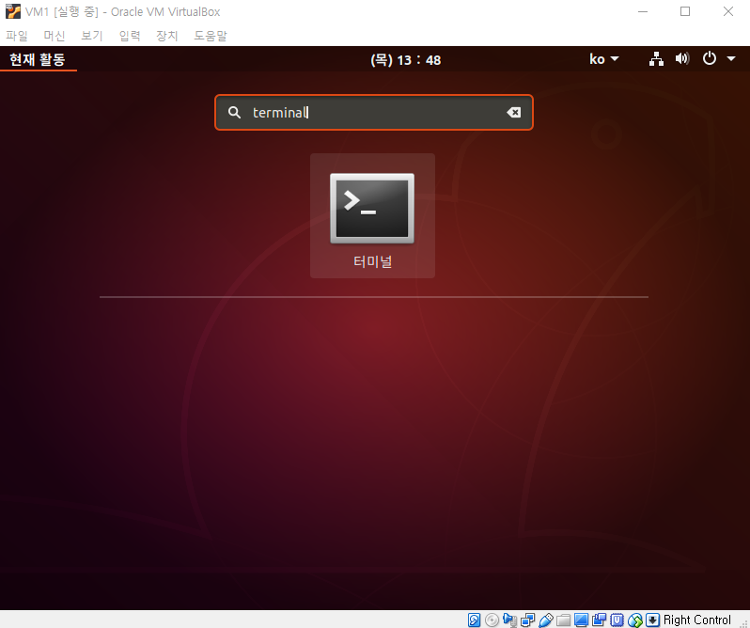
Linux Quick Overview

Slide 24
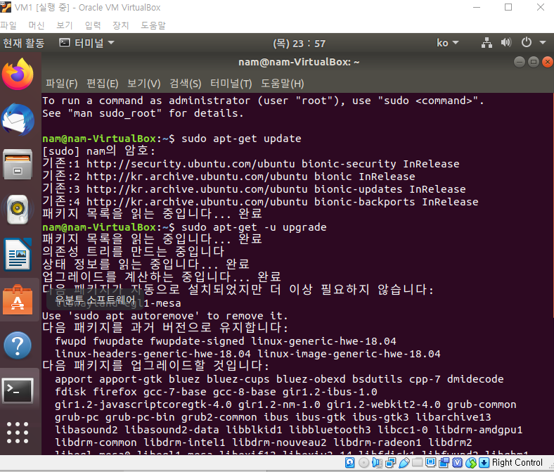
Linux Installation Continue
sudo apt-get update
sudo apt-get –u upgrade
Input your password
(not printed)
* Don’t upgrade Ubuntu Version
* sudo : command to grant root

Slide 25
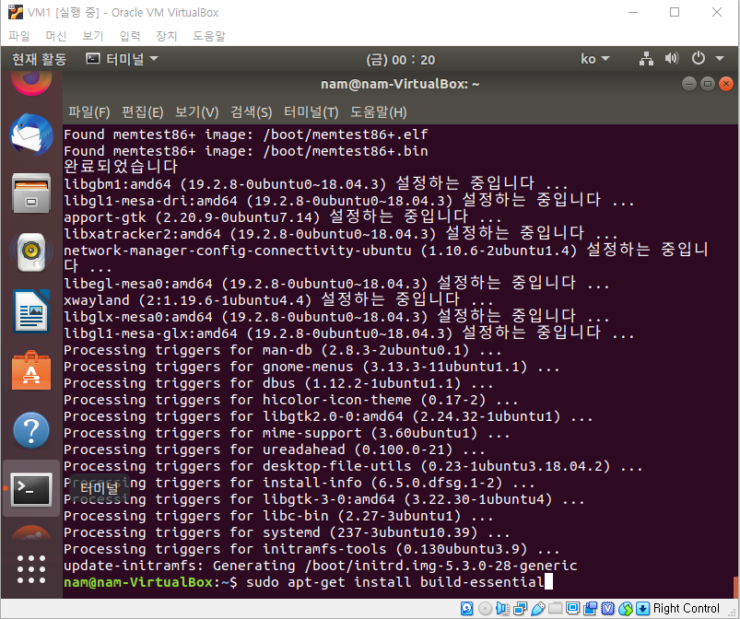
Linux Installation Continue

Slide 26
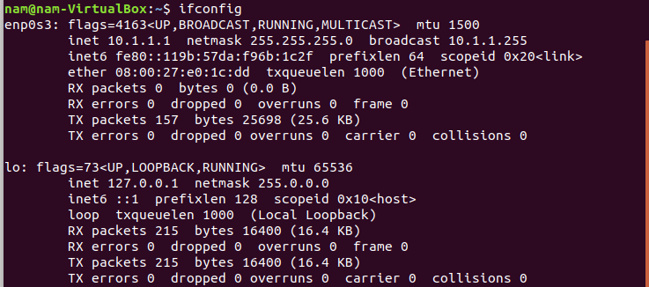
Linux Installation Continue
Type ifconfig and it operates => OK

Slide 27
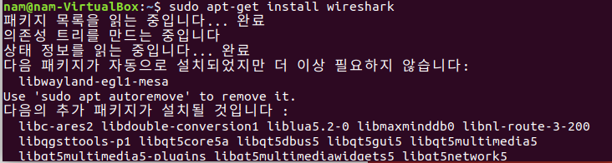
Wireshark Installation
.
.
.

Slide 28
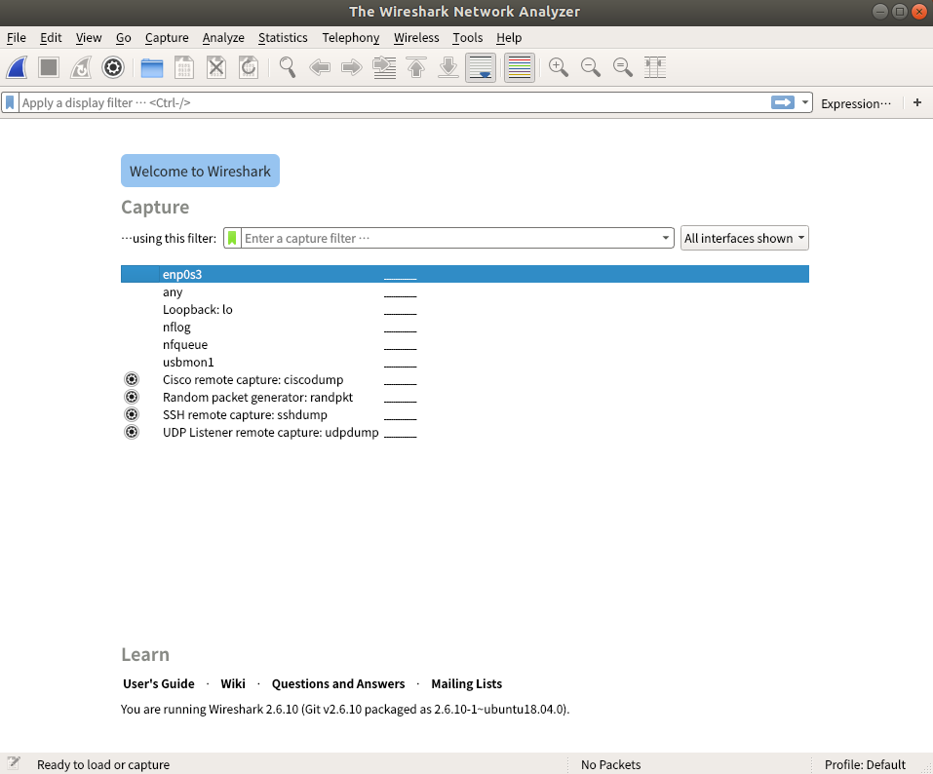
Wireshark Installation

Slide 29
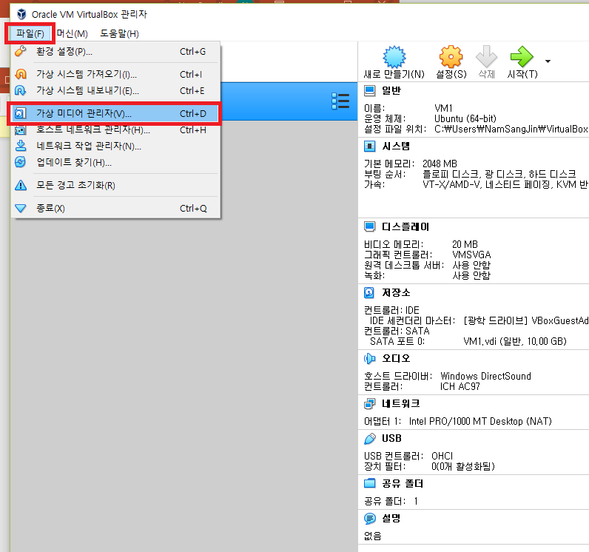
Replicating VMs
* Turn off VM1

Slide 30
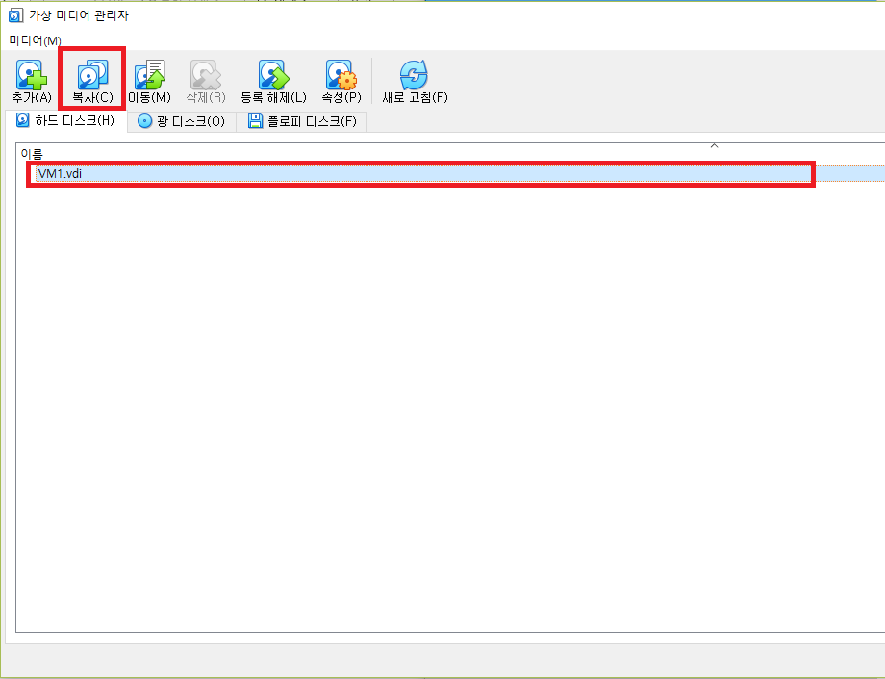
Replicating VMs

Slide 31
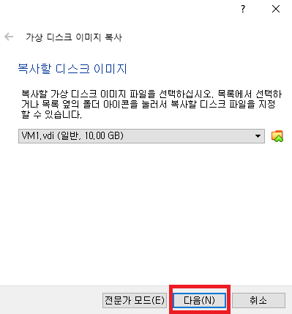
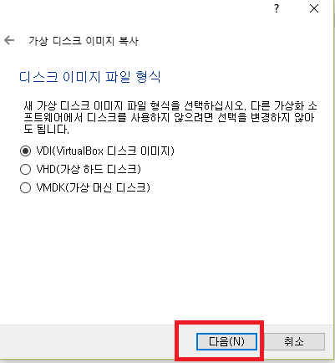
Replicating VMs

Slide 32
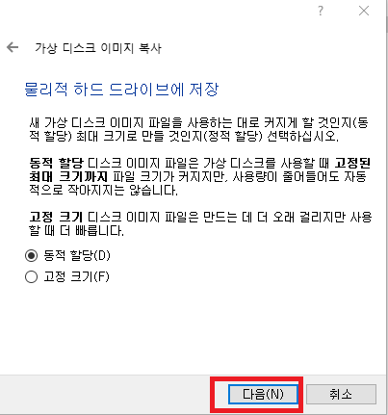
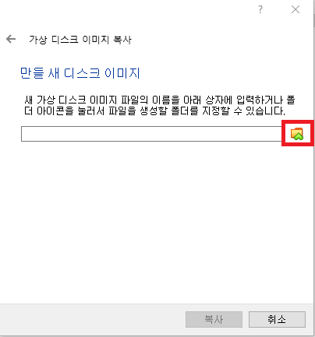
Replicating VMs

Slide 33
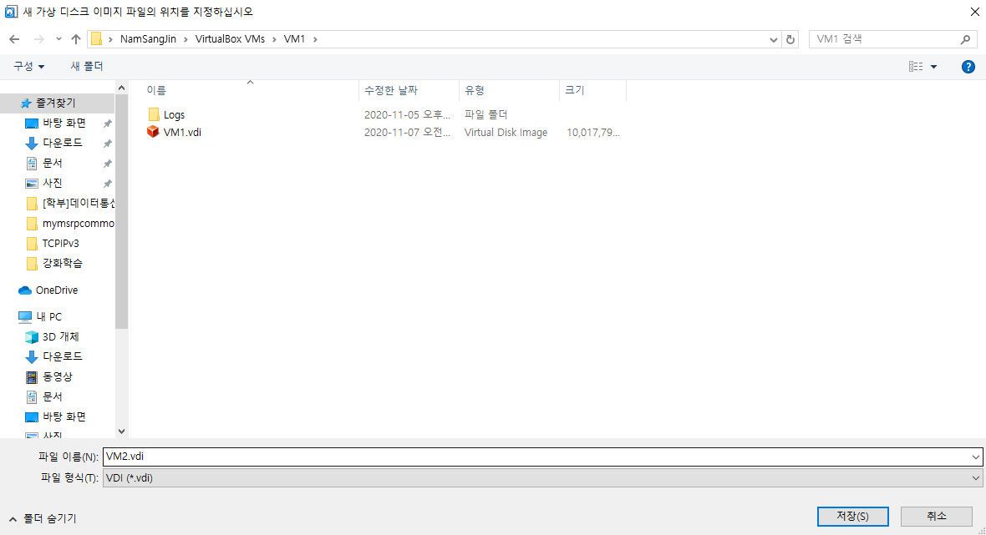
Replicating VMs

Slide 34
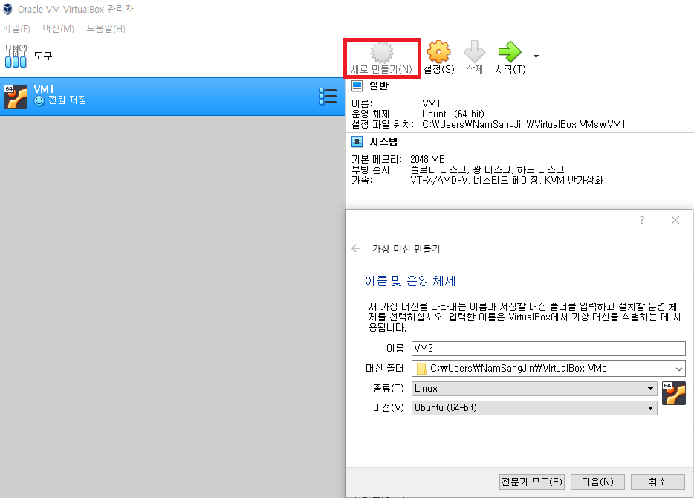
Replicating VMs

Slide 35
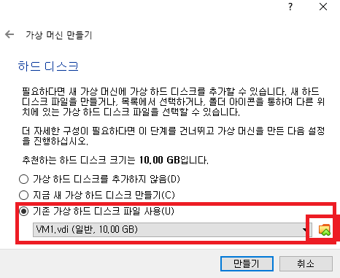
Replicating VMs

Slide 36
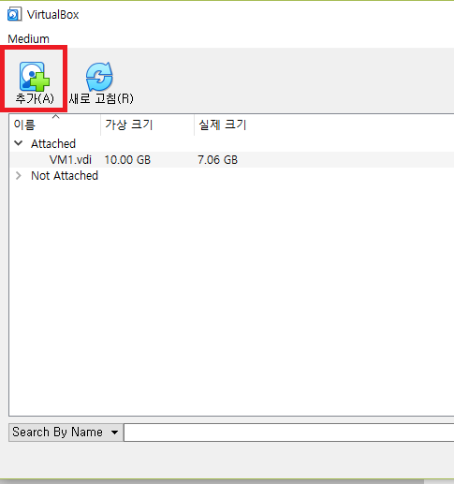
Replicating VMs

Slide 37
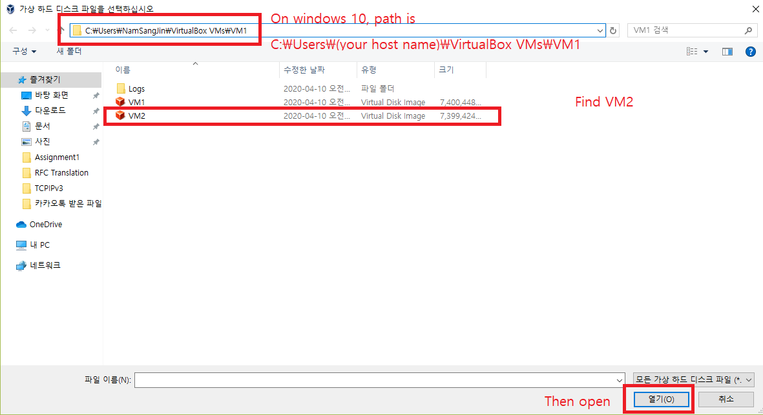
Replicating VMs

Slide 38
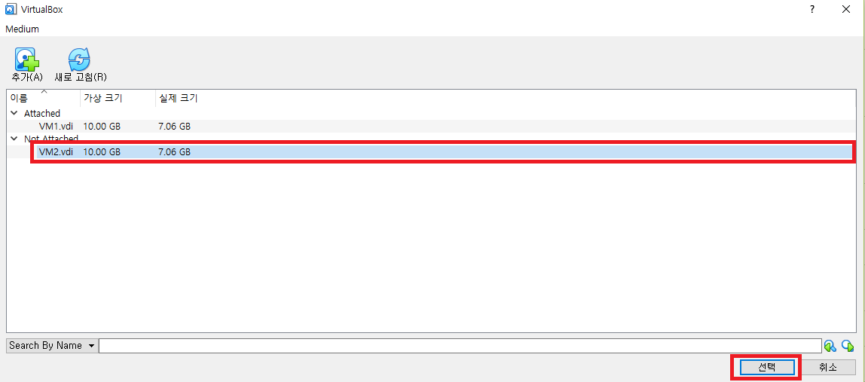
Replicating VMs

Slide 39
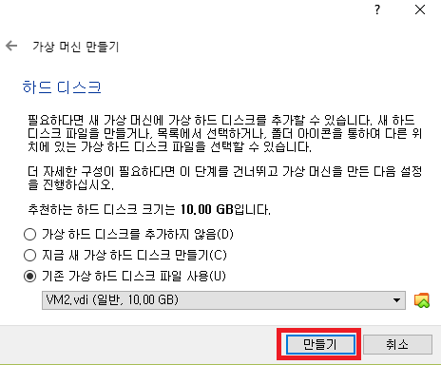
Replicating VMs

Slide 40
Replicating VMs
Follow slides 29 ~ 39 to create VM2
For each VM (1, 2), follow the next slide

Slide 41
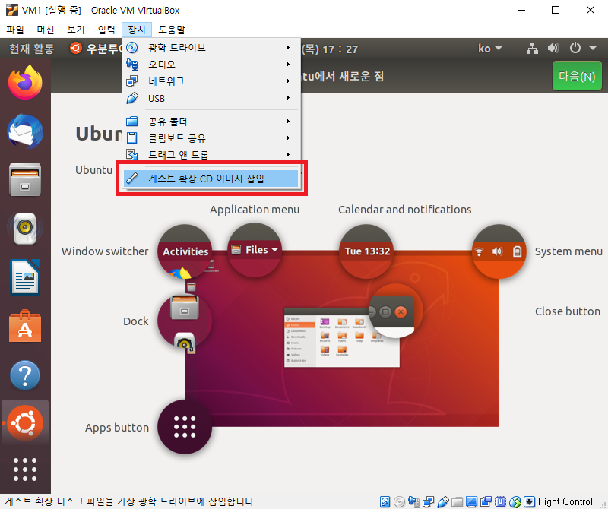
Linux Installation Continue
Finally, sudo reboot

Slide 42
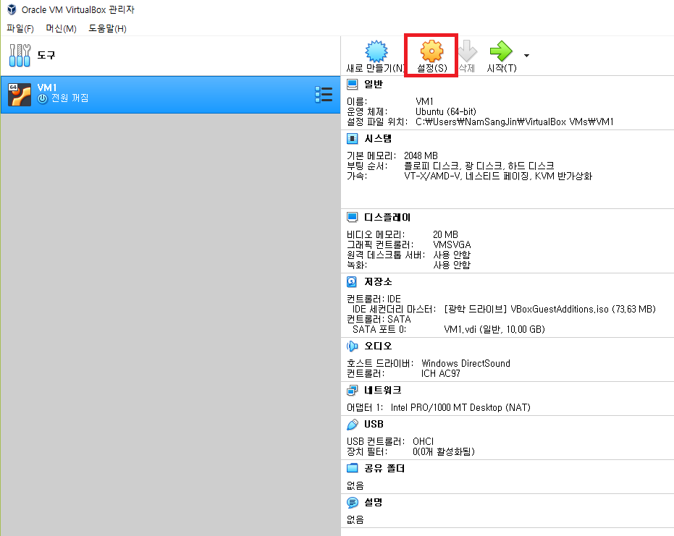
Additional Setup
Check whether VM is off.

Slide 43
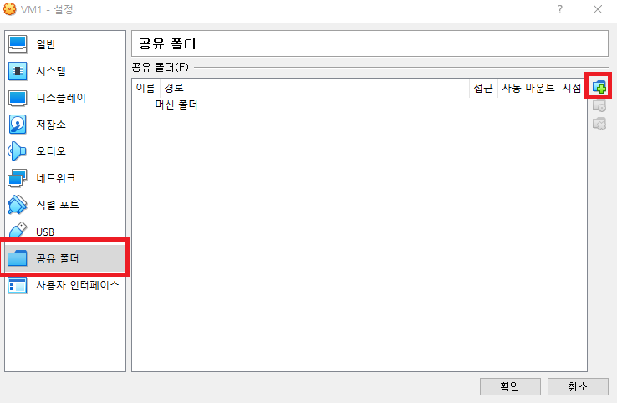
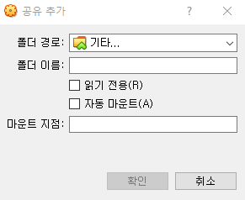
Additional Setup

Slide 44
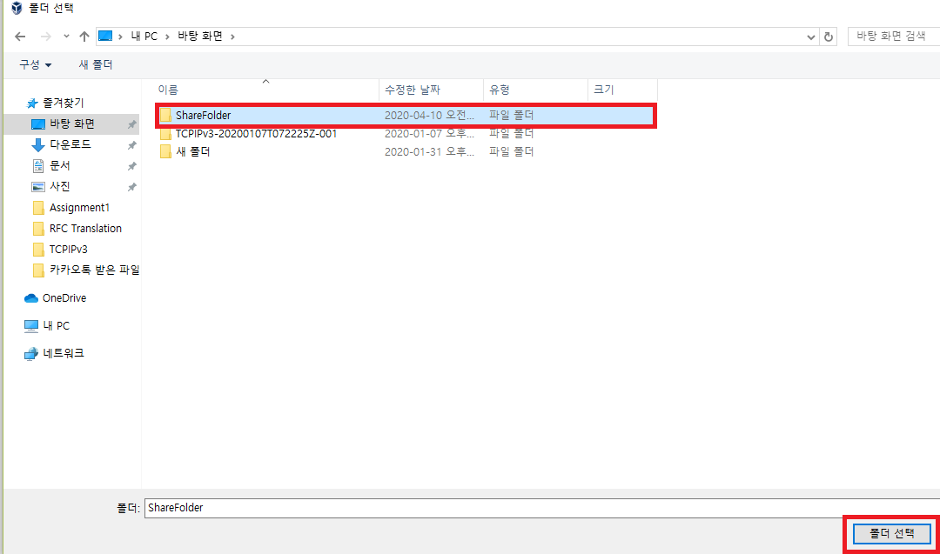
Additional Setup

Slide 45
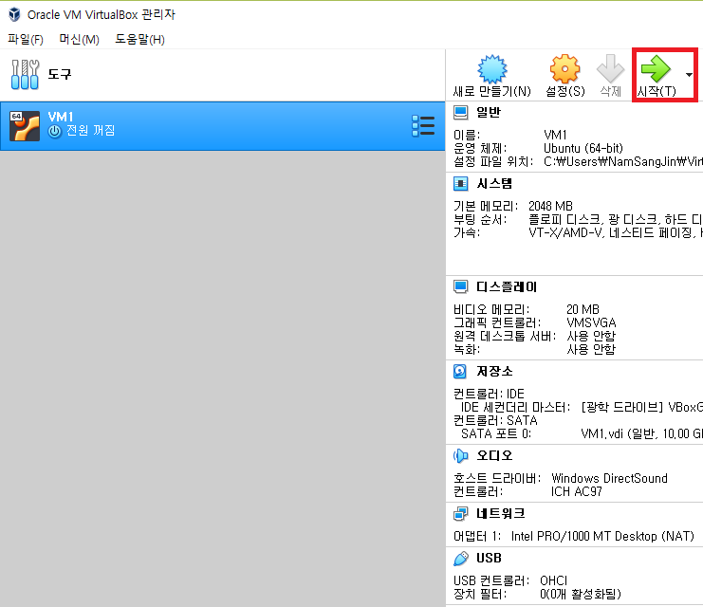
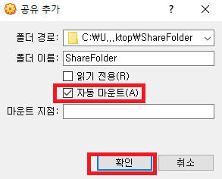
Additional Setup
Click OK, OK

Slide 46
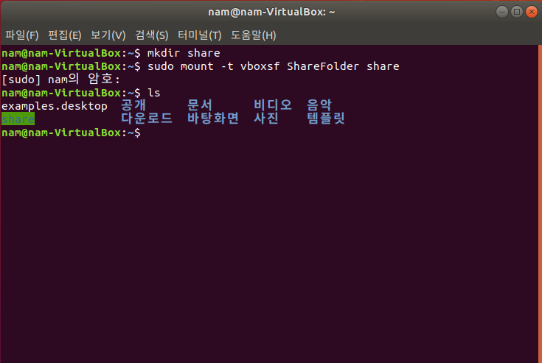
Additional Setup
Turn on terminal, and
**
Red – folder name
on the host os (Windows)
Green – folder name
in a VM
**

Slide 47
Additional Setup
Whenever you restart a VM, input the command in the slide 46 to use folder sharing

